Slide 1
A Lock-Assisted Lightweight Quorum Validation
Model for Double-Spend Prevention in Hash-Chain
IoT Micropayments
MUSTAFA CAN ÇALIŞKAN, 504251544
BLG 640E - Security in Financial Information Systems
Notes:
"Hello everyone. Today I will present my work — a small and light payment system for IoT devices. My main goal is to stop double-spending without using a blockchain. Let's start."

Slide 2

The Problem
IoT devices: many small payments, sometimes one cent
Blockchain is too slow and too expensive for this
Double-spending: same coin sent to two merchants at the same time
Question: Can I prevent double-spending without a full blockchain?
Stock photo source: https://www.globalsign.com/en/blog/what-internet-things-and-how-does-it-work
Notes:
"Imagine an IoT world. Smart sensors, electric car chargers, small APIs. They all need to make many tiny payments — sometimes only one cent each.
Blockchains like Bitcoin do not fit this case well. They are slow, and the transaction fee can be bigger than the payment itself. So we need something lighter.
But there is also a security problem. The payer can send the same coin to two different shops at the same time. We call this 'double-spending.' If both shops accept it, the payer wins twice — and the system loses trust.
So my question is simple: can I prevent double-spending without a full blockchain?"

Slide 3
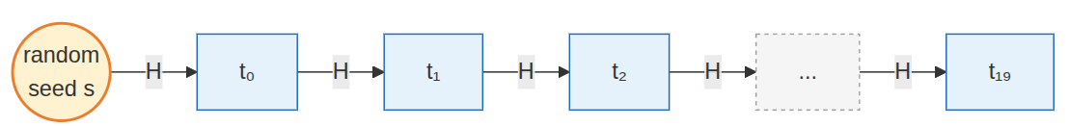
Hash Chain Refresher
Hash function (e.g. SHA-256): easy forward, almost impossible backward → "one-way"
Build a chain: start from a seed, hash again and again → t₀, t₁, t₂, ...
Each payment reveals one token + its predecessor
Verifier does one hash to check → very cheap
Notes:
"To make payments cheap, I use a hash chain.
A hash function — like SHA-256 — turns any input into a fixed-size number. It is easy to compute forward, but almost impossible to reverse. We call this 'one-way.'
So I take a random seed and hash it many times. This gives me a chain of tokens. Each one is the hash of the previous.
For each payment, I send one token plus the one before it. The merchant does only one hash to verify: if H of the previous equals this one, the token is valid.
This is very fast and very small — exactly what tiny IoT devices need."

Slide 4
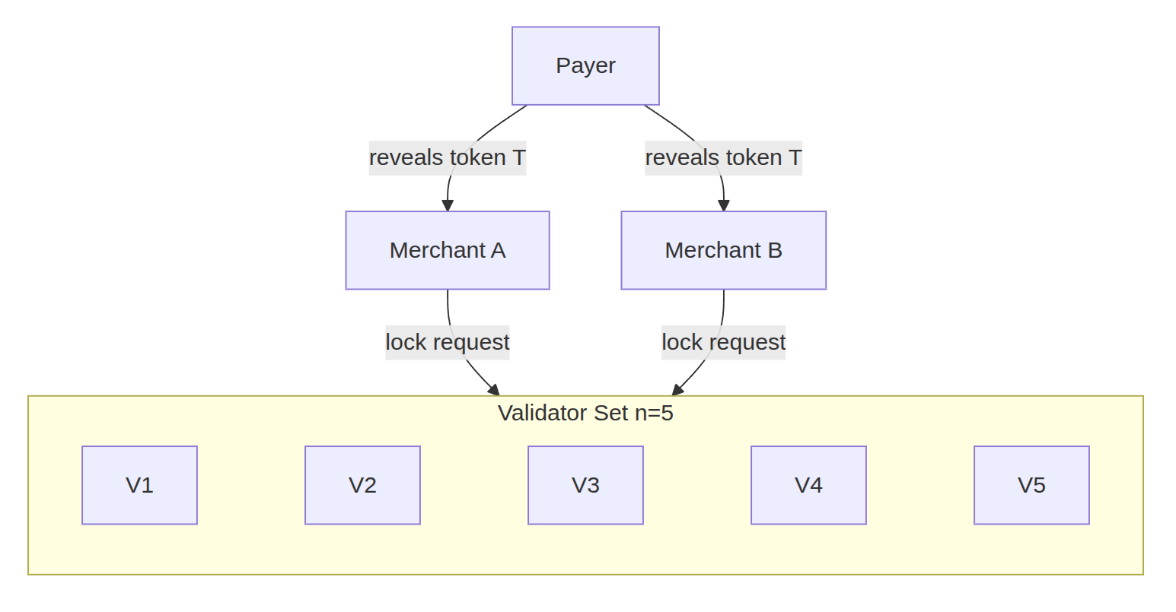
My Approach: Validators + Quorum
Validators: a small fixed group of simple servers (5 in my system)
Each validator only remembers which tokens are already spent — nothing else
Quorum: the merchant needs q out of n approvals (e.g. 3 of 5)
A lock step is added before final approval → main contribution, next slide
Notes:
"This diagram shows my system.
At the top, the payer reveals the same token T to both merchants — this is exactly the double-spend attack I want to stop.
In the middle, two merchants. At the bottom, five validators. The validators are simple servers — not a blockchain. They only remember which tokens are already spent.
As the arrows show, each merchant sends a lock request to the validators. But the merchant does not need every validator to say yes. It only needs q out of n approvals — for example, three out of five. We call this number the quorum.
The lock step you see in the diagram is my main contribution. I will explain how it works in the next slide."

Slide 5
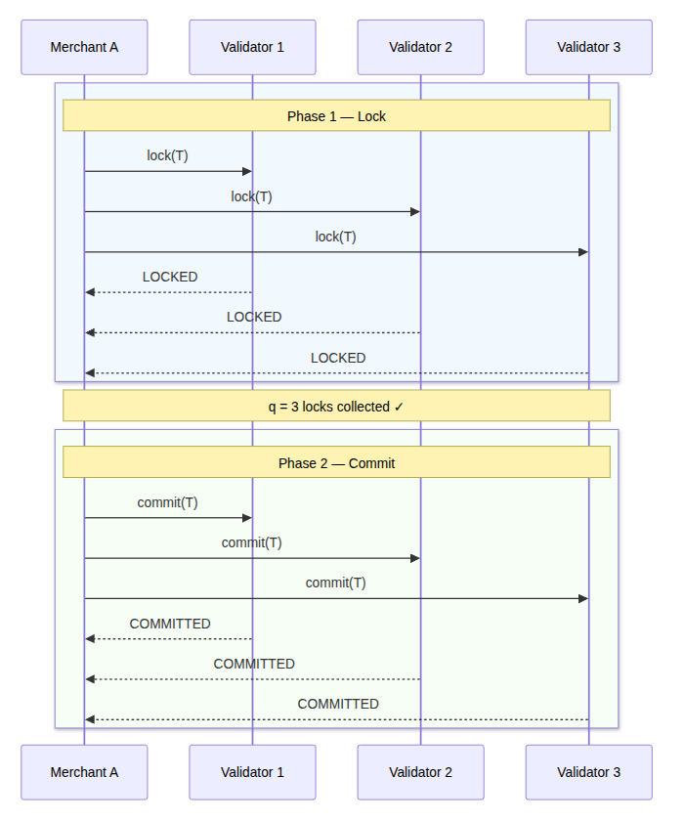
Lock/Lease: Two-Phase Protocol
Phase 1 — Lock
Merchant asks all validators to lock the token
Validator checks: (1) hash valid? (2) not spent? (3) not locked by another?
If OK → lock with a lease (short timeout)
Phase 2 — Commit
Merchant has ≥ q locks → asks validators to commit
Validator marks the token as permanently spent
If commit does not arrive in time → lock expires automatically
Per validator: first request wins, second is rejected
Notes:
"Now let me show how the lock works. There are two phases — you can see them on the right.
In phase one, the merchant asks all validators to lock the token. Each validator checks three things: is the hash valid, is the token not spent, and is it not already locked by another merchant.
If all three pass, the validator returns LOCKED — but only for a short time. This time limit is called the lease. If commit does not arrive in time, the lock expires automatically.
In phase two, when the merchant has at least q locks, it sends a commit message. Each validator then marks the token as permanently spent.
The key idea is that a validator can lock a token for only one merchant. First request wins, second is rejected. But what if different validators pick different merchants? The next slide answers exactly that."

Slide 6
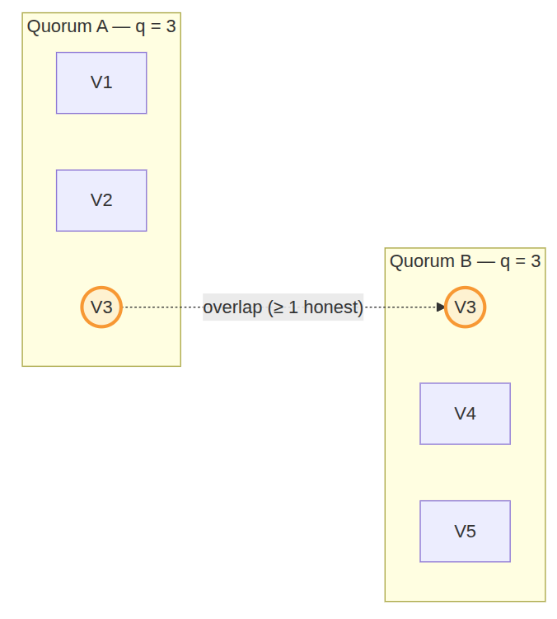
Safety Condition
Safety condition: 2q − n ≥ f_b + 1
n : total validators · q : quorum size · f_b : byzantine (malicious) validators
Two quorums of size q must overlap by at least 2q − n validators
Overlap must contain at least one honest validator
Example. n = 5, f_b = 2 → need q ≥ 4 (q = 3 is not enough)
Notes:
"So why does the lock actually stop double-spending? The answer is this safety condition.
In the formula, n is the total number of validators, q is the quorum size, and f-b is the number of malicious validators we tolerate.
Look at the picture. On the left, Quorum A approves merchant A. On the right, Quorum B approves merchant B. Notice that V3 appears in both groups — it is the same validator, shared by the two quorums. This is the overlap.
In general, two quorums of size q must share at least 2q minus n validators. For safety, that overlap must contain at least one honest validator. That is exactly what the formula says.
For example, with five validators and two malicious ones, q must be at least four. Three is not enough."

Slide 7
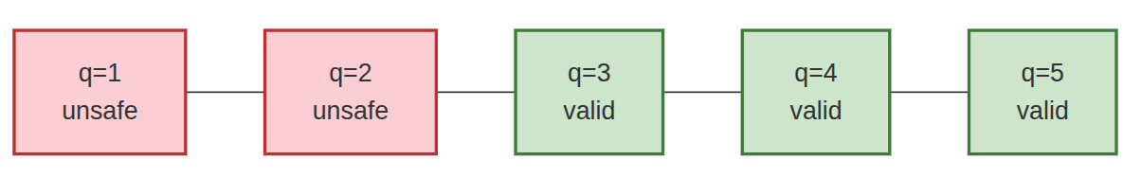
Liveness & Trade-off
Liveness condition: n − f_c ≥ q
f_c : number of crashed (silent) validators
Need enough alive validators to form a quorum
Trade-off: larger q → safer, but less tolerant to crashes
Valid range: ⌈(n + f_b + 1) / 2⌉ ≤ q ≤ n − f_c
Notes:
"Now I look at liveness — can the system still work when some validators crash?
The condition is simple. If at most f-c validators crash, n minus f-c must be at least q. In words, enough validators must stay alive to form a quorum.
For example, with five validators and q equal to three, the system survives two crashes. If three crash, only two are alive — no quorum, no payments.
There is a trade-off here. A bigger q gives more safety because the overlap is larger. But it also reduces liveness, because more validators must stay online.
In the picture, with no faults, the valid range is q from three to five — the green zone. As I add malicious or crashed validators, this zone shrinks. For n equals five, the range can even become empty. That is why I test the two fault types separately in my experiments."

Slide 8
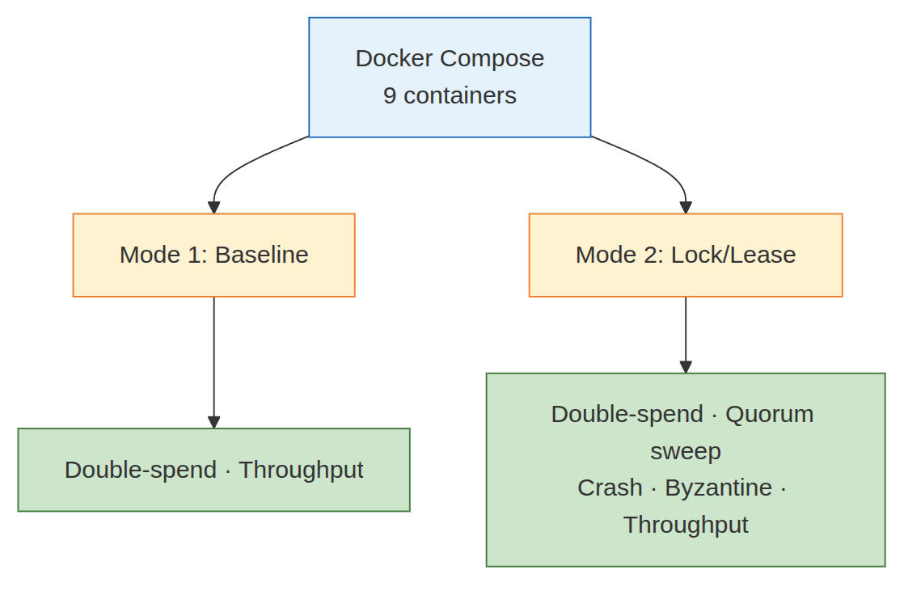
Experimental Setup
Real running system on Docker Compose — 9 isolated containers
1 payer · 2 merchants · 5 validators · 1 experiment runner · 1 reporter
Stack: Python 3.11 + FastAPI + HTTP between containers
Two modes compared:
Baseline: simple spent-check (no lock)
Lock/Lease: my two-phase protocol
Faults simulated:
Crash: container stopped
Byzantine: env flag → validator approves everything
Scale: 14 scenarios · 100 runs each (50 for throughput) · 20-token chains
Notes:
"Now let me describe my setup. I built a real running system, not just a math simulation.
Each component runs in its own Docker container — one payer, two merchants, five validators, an experiment runner, and a reporter. They communicate over HTTP, like real distributed nodes.
I compare two protocol modes — the baseline with only a spent-check, and my lock-lease protocol with the two phases I just showed.
I run fourteen experiment scenarios, each repeated a hundred times, with twenty-token hash chains. I simulate crashes by stopping a container, and byzantine faults by a config flag that makes a validator approve every request."

Slide 9
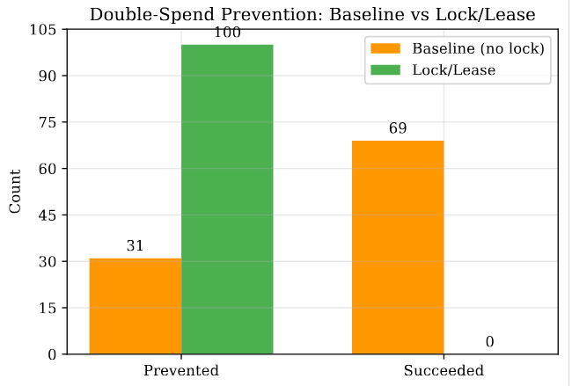
Result 1: Lock/Lease vs Baseline
Setup: n = 5, q = 3, 100 double-spend attempts
Lock/Lease: 100 / 100 prevented → 100 %
Baseline (spent-check only): 31 / 100 prevented → 31 %
69 baseline runs → both merchants accepted the same token
Cause: non-atomic read-then-write inside the validator (race condition)
Lock/Lease closes this gap: first lock request wins, second is rejected
Notes:
"Now the key question — does the lock actually help? I run the double-spend attack one hundred times, with five validators and quorum three.
As you can see in the figure, the lock-lease bar shows one hundred percent prevention — all hundred attacks blocked.
The baseline bar shows only thirty-one percent. In the other sixty-nine cases, both merchants accepted the same token, and the double-spend succeeded.
Why does the baseline fail? The validator first reads the spent set, and then writes to it. Between these two steps, another request can come in. Both merchants see the token as unspent, and both get approval.
The lock-lease protocol closes this gap. First request wins, second is rejected."

Slide 10
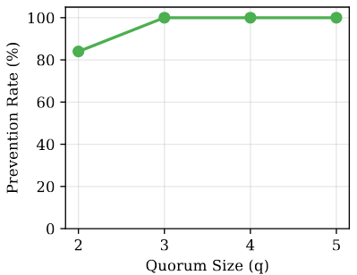
Result 2: Quorum Size Sweep
Setup: lock/lease, n = 5, no faults, 100 runs per q value
q = 2 → 84 % (quorums can pick different validators)
q = 3 → 100 % (any two quorums share ≥ 1 validator)
q = 4, 5 → 100 %
Latency: ~ 45 ms across all q values
Messages: 15 per attempt — constant
→ bigger q gives more safety with almost no extra cost
Notes:
"Now I change the quorum size. I keep five validators with no faults, and run a hundred double-spend attempts for each q from two to five.
As you can see in the figure, with q equals two, prevention drops to eighty-four percent. The reason is simple — two quorums of size two can pick different validators. They do not always share one.
When q is three or more, prevention reaches one hundred percent. Out of five validators, any two groups of three must share at least one. That one honest validator blocks the second merchant.
I also measure latency and message count — they barely change. Latency stays around forty-five milliseconds, and the message count stays at fifteen per attempt. So a bigger q gives more safety with almost no extra cost."

Slide 11
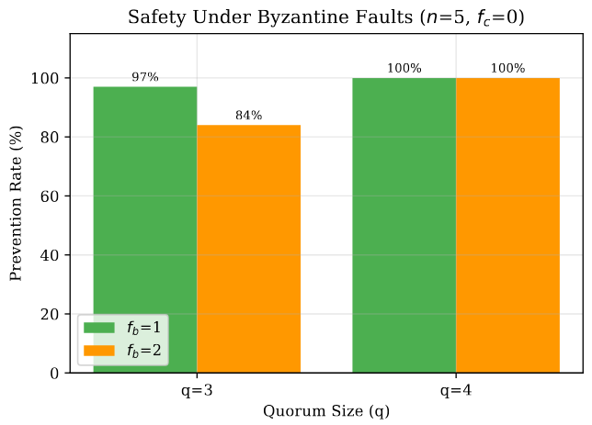
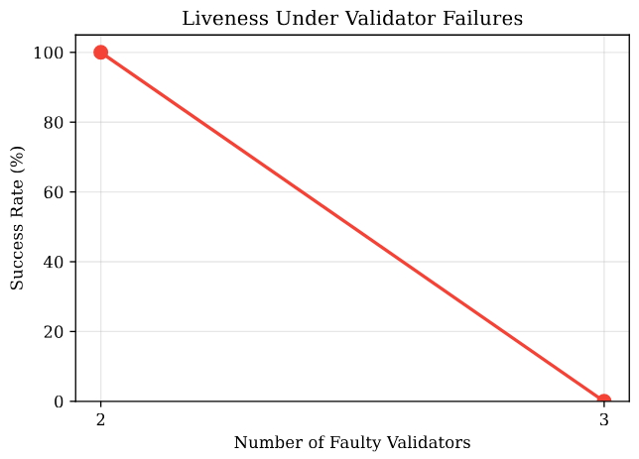
Result 3: Crash & Byzantine Faults
Crash tolerance (lock/lease, q = 3):
f_c = 2 → 3 alive ≥ q → 100 % success
f_c = 3 → 2 alive < q → 0 % success
Byzantine safety (lock/lease, f_c = 0):
q = 4, f_b = 1 safe (3 ≥ 2) → 100 %
q = 4, f_b = 2 safe (3 ≥ 3) → 100 %
q = 3, f_b = 1 unsafe (1 < 2) → 97 %
q = 3, f_b = 2 unsafe (1 < 3) → 84 %
→ Experiments match the theoretical conditions exactly
Notes:
"Now I test the two fault types — crashes first, then byzantine validators.
In the bottom figure, you can see crash tolerance with quorum three. With two crashed validators, three are alive — just enough for a quorum, and all hundred payments succeed. With three crashed, only two are alive, and success drops to zero.
The top figure shows byzantine safety. When the safety condition holds — q equals four — prevention stays one hundred percent, even with two malicious validators.
When the condition is violated — q equals three — prevention drops. Ninety-seven percent with one byzantine validator, and eighty-four percent with two.
The numbers match the theory exactly. The two conditions from earlier slides are not just math — they predict real behavior."

Slide 12
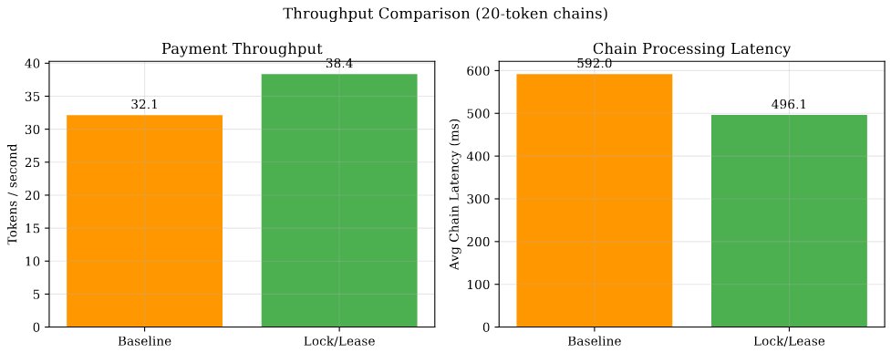
Result 4: Throughput
Setup: 20-token chain, sequential processing, 50 runs
Lock/Lease: 38.4 tok/s · ~ 25 ms per token · chain in 496 ms
Baseline: 32.1 tok/s · chain in 592 ms
Caveat: baseline has a built-in non-atomic delay (the race window)
comparison shows correctness behavior, not raw speed
Take-away: 25 ms per token is fast enough for IoT micropayments
Notes:
"My last result is throughput. I process a full chain of twenty tokens in sequence, fifty times.
In the figure, the lock-lease protocol handles thirty-eight tokens per second — about twenty-five milliseconds per token. The baseline handles thirty-two.
I want to be honest about this comparison. The baseline has a small built-in delay between read and write — that is the race window I added to model real distributed systems. So the speed difference reflects that delay, not a real advantage of locking.
The main benefit of lock-lease is correctness, not speed. But the important number here is twenty-five milliseconds per token. That is fast enough for IoT micropayments — the protocol is practical."

Slide 13
Conclusion + Future Work
What I built
Hash chain + small validator quorum + two-phase lock/lease
No blockchain · No global consensus · Simple servers
What I proved (formal)
Safety: 2q − n ≥ f_b + 1
Liveness: n − f_c ≥ q
What I measured (14 scenarios, 100 runs each)
100 % double-spend prevention under safe configurations
25 ms per token · 38.4 tokens / second
Theory and experiments match exactly
Future work
Larger validator sets (n = 7, 9)
Wide-area network conditions (delay, packet loss)
Dynamic validator membership (join / leave at runtime)
Notes:
"Let me wrap up.
I built a lightweight payment system for IoT — a hash chain plus a small validator quorum plus a two-phase lock-lease protocol. No blockchain, no global consensus, just simple servers.
I proved two formal conditions — safety and liveness — and validated both with experiments.
The headline result is one hundred percent double-spend prevention under safe configurations, with twenty-five milliseconds per token. Theory and experiments match exactly.
For future work, I plan larger validator sets, wide-area network conditions, and dynamic validator membership where validators can join and leave during operation."

Slide 14
THANKS FOR LISTENING!

